Slide 1
Final Project
Electronic Commerce

Slide 2
Aplication
Data Base
MySql
Back End
Java (NetBeans)
Spring Boot
JWT
Front End
Website (React Js)
Mobile (React Native)

Slide 3
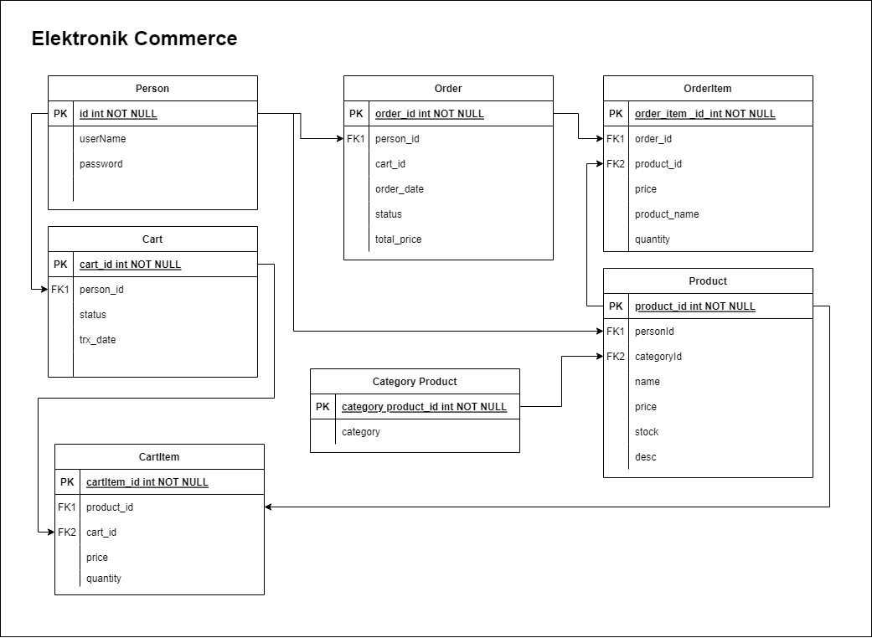
ERD

Slide 4
Demo Aplikasi

Slide 5
Thanks!

